Slide 1
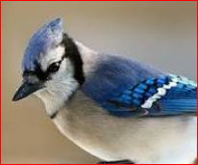
Welcome to UTM Team J Project presentation
Team Members
Raghavendra Samaga (Raghu)
Joonho Ye
Wilfred Valencia(Wil)

Slide 2

Data Preparation
Select data source
World Health Organization
https://data.worldbank.org
https://en.wikipedia.org/wiki/List_of_countries_by_past_and_projected_GDP_(nominal)
Identify critical features: Transport accidents, Falls, Accidental drowning and submersion, Exposure to smoke, fire and flames, fire and flames, Accidental poisoning by and exposure to noxious substances, Intentional self-harm(Suicide), Assault and all other external causes- Total and both sexes
Treating Missing values
Additional information: Population/Income level/ Global Peace ranking

Slide 3
Analysis
1
Classification of data
2
Prediction of mortality
3
Trend Analysis/ Correlations

Slide 4
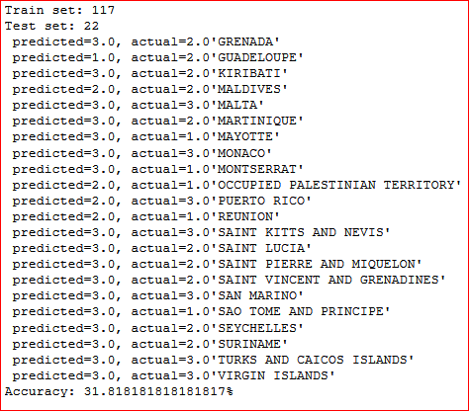
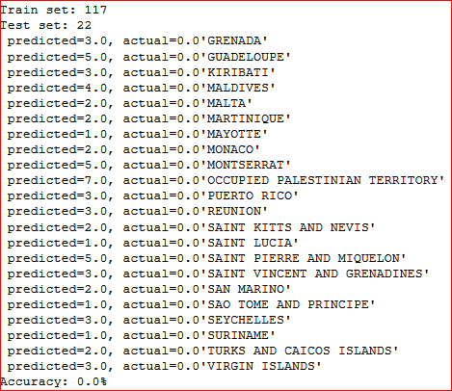
Classification : KNN
Income level Ranking: 1 Low Income to 3 High Income
Global Peace Ranking: 1 being Safest to 7 Unsafe

Slide 5
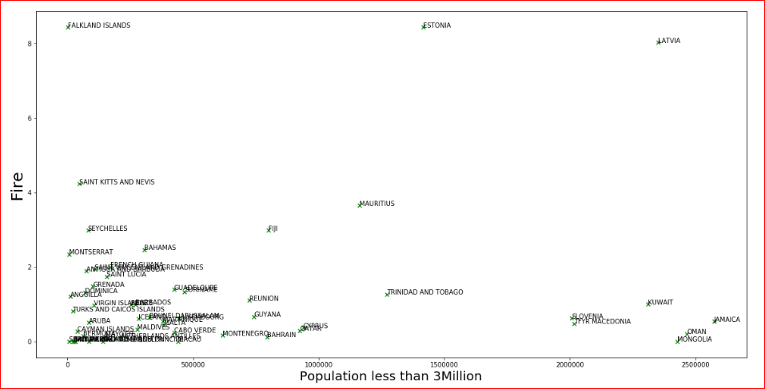
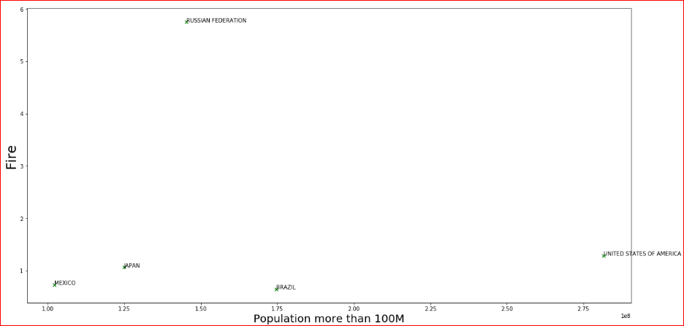
Scatter Plot
Fire vs Population graph for countries with less than 3M population
Fire vs Population graph for countries with less than 100M population

Slide 8
Thank you!
Questions?

Slide 9

More questions about Project?
References:
GitHub repository: https://github.com/rsbtoronto/UofTTeamJTermProject
WHO data: http://apps.who.int/healthinfo/statistics/mortality/whodpms/
Wikipedia : GDP/Income Level/ Population count
Google
Notes:
In Slide Show mode, select the arrows to visit links.

